Slide 1
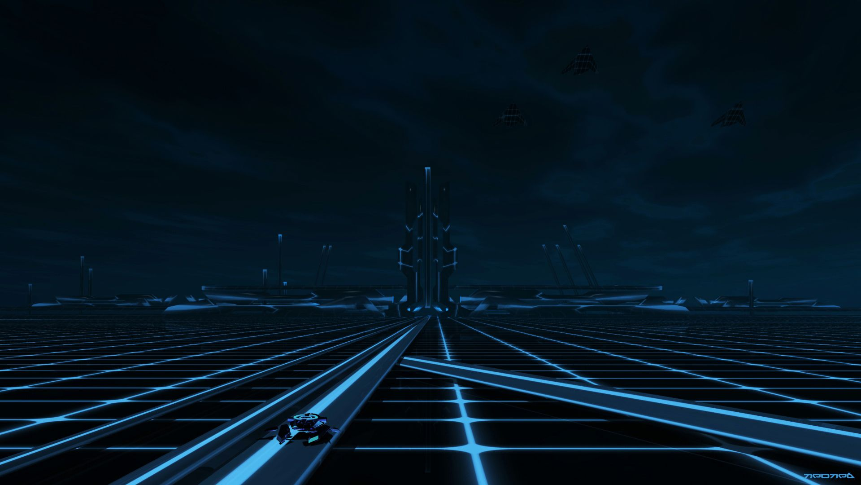


Project-1: Archery Game
CME1251 Project Based Learning
BY
2020510171 SUDE KÜNDÜROĞLU
2020510201 ZÜBEYDE ELİF ARAL
2021510119 EMRE KERMAN

Slide 2

TABLE OF CONTENTS
02
Progress Summary
03
Problems Encountered
01
Introduction
04
Conclusion

Slide 3
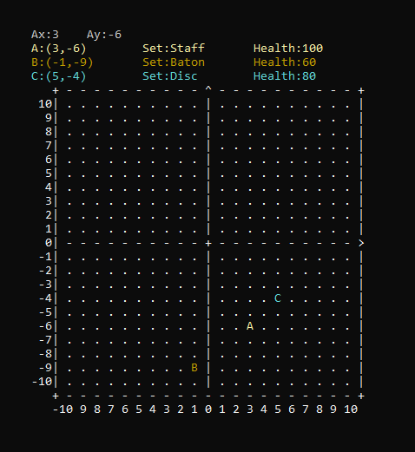

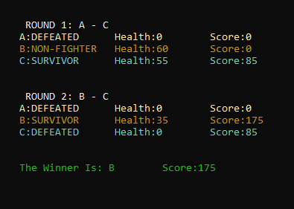

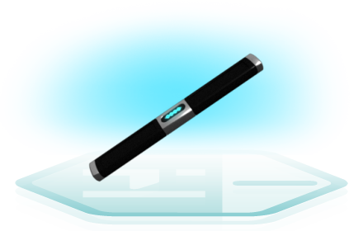
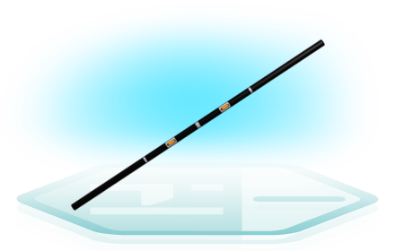
01 INTRODUCTION
Tron is an adventure game played on -10 by 10 coordinate plane. Your goal is to defeat your two enemies and get as many points as you can.
You will enter x and y axis and you will get a randomly weapon. Your enemies also get randomly weapons and they will placed randomly.
There are two rounds and every round only two users will fight.

Slide 4
01
Requirements
Task Sharing & Scheduling
Completed Tasks & Incomplete Tasks
Additional Improvements
PROGRESS SUMMARY

Slide 5

REQUIREMENTS
Getting coordinates from player.
Placing opponents (B and C) randomly.
Setting three sets and health randomly for those three opponents.
Showing player and other opponents in coordinate plane.
Finding minimum distance between three opponents.
Finding who wins while two opponents in fight.
Making two rounds then setting the winner of this game.

Slide 6
TASK SHARING & SCHEDULING
SUDE KÜNDÜROĞLU
EMRE KERMAN
ZÜBEYDE ELİF ARAL
+Helped while making flowchart.
+Wrote the main code
+Added color statements into code.
+Made last version of flowchart.
+Solved most of the problems and made algorithms for solving.
+Helped while writing code.
+Made first version of flowchart.
+Helped while writing code.
+Helped while solving problems.

Slide 7
SCHEDULING
WEEK 2
WEEK 3
We decided to divide first part of the code by three.
We code one by one and sum all of them.
We wrote a mid report.
We already made a main flowchart so we tried to wrote the code by ourselves.
We choose the best code in our codes.
WEEK 4
WEEK 1
We met with group members.
Planed what we are going to do, and we made a brainstorm.
We all made flowchart by ourselves and combined with each other.
We made powerpoint presentation and a game poster.
We wrote final report.

Slide 8
COMPLETED TASKS
INCOMPLETE TASKS
Getting coordinates from user
Showing coordinate table and on that table showing players
Assign set and health variables randomly to opponents.
Calculating distance, comparing assigned sets and calculating scores.
Showing rounds, scores and winners.
There is no incomplete tasks because we found a solution for all our problems, we add improvements to our code.

Slide 9
ADDITIONAL IMPROVEMENTS
Monkey Test
We add monkey test in our code because we want to our code work correctly.
Console Colors
We add color to opponents by getting sets because we want to be colorful.
We add a theme and a little bit story to our game becasue we want to be more playable game.
Theme

Slide 10
02
Randomizing Sets And Health Statements
Printing The Coordinate Plane & Showing Players
PROBLEMS ENCOUNTERED

Slide 11
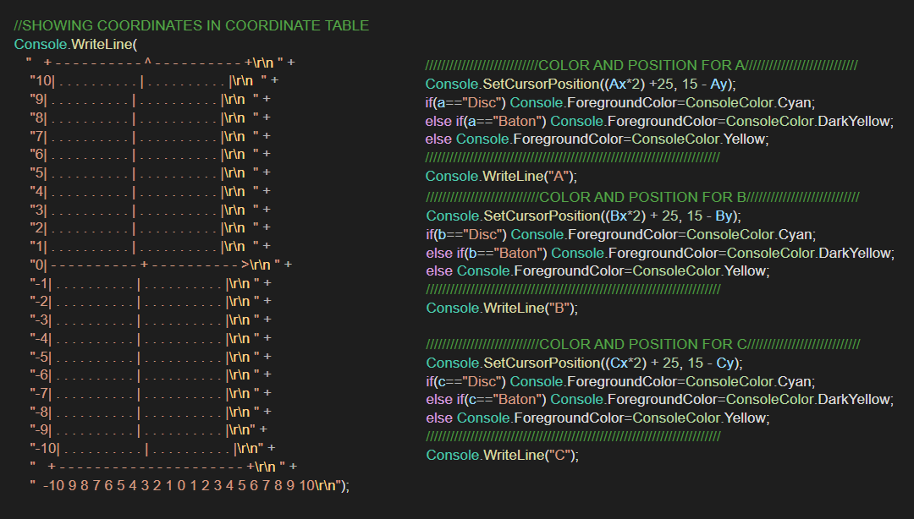
Printing The Coordinate Plane & Showing Players

Slide 12
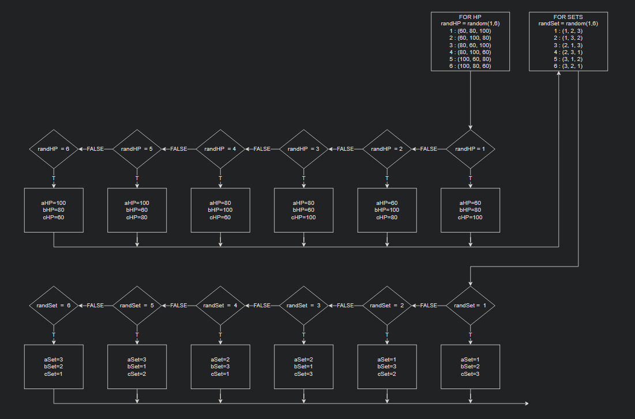
Randomizing Sets And Health Statements

Slide 13
03
In this project we learned;
How to overcome problems with a limited set of tools
Development with a team and workflow
Improvise, adapt, overcome
Conclusion

Slide 14
THANK YOU FOR EVERYONE WHO LISTENED US
RESOURCES
https://tron.fandom.com/
https://dolimg.com/franchise/tron/html/codex/tron-weapons.html#

